Slide 1

IMAGE COMPONENT DETECTOR
Members:-
Chinmay Mandavkar
Gaurav Kumar
Aman Bharti
Aman raj

Slide 2
1
INTRODUCTION
Main aim of this project is to extract important data from images. Using this extracted information description, interpretation and understanding of the scene can be provided by the machine.

Slide 3
1
Features :-
Object detection
Color detection
Object tracking is the process of locating an object or multiple objects using either a static or dynamic camera.
Color detection is necessary to recognize objects, it is also used as a tool in various image editing and drawing apps.
Image recognition
Image processing
The component of image can be recognised using different Ml algorithms or We can use the services provided by aws cloud or google
Image processing refers to different opperation done on the image to extract the important features and by using it we can perform recognition operations.
Image detector
Face detection
Machine learning
For face detection many libraries are available. we have used opencv-Haarcascade classifier for classifying the face
Today, examples of machine learning are all around us. Digital assistants search the web and play music in respond to our voice commands

Slide 4
2
Proposed System
Block Diagram , Flow Charts and Future Ideas

Slide 5
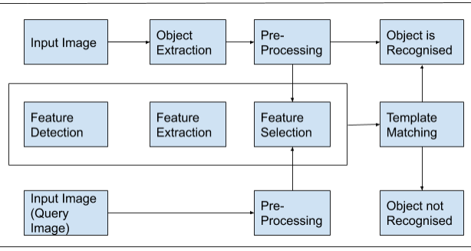
2
Block diagram

Slide 6
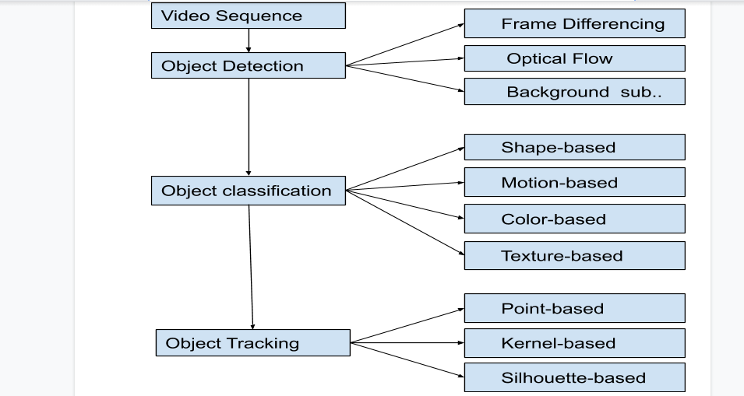
2
Flow Chart

Slide 7
3
Implementation
Object Detection , Celebrities detection

Slide 8
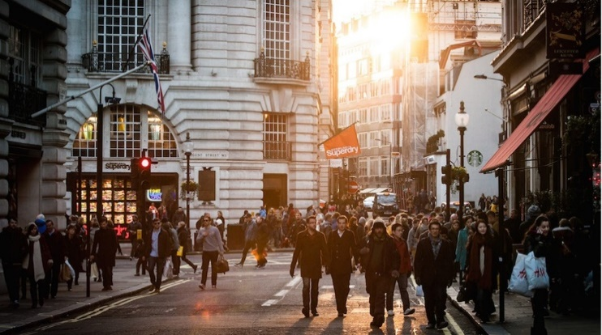
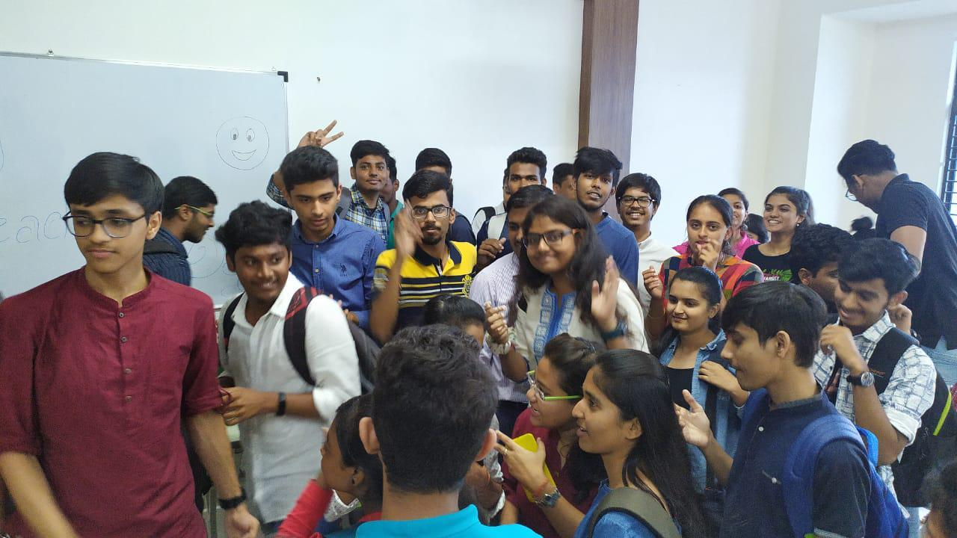
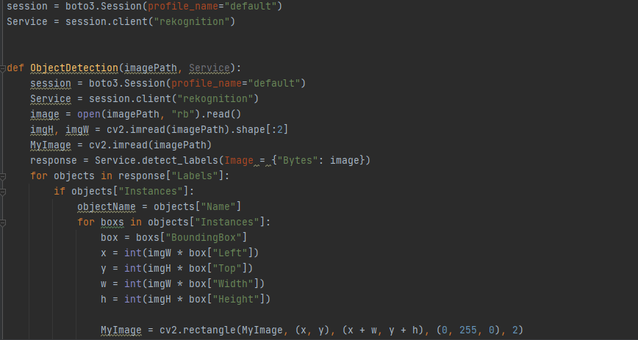
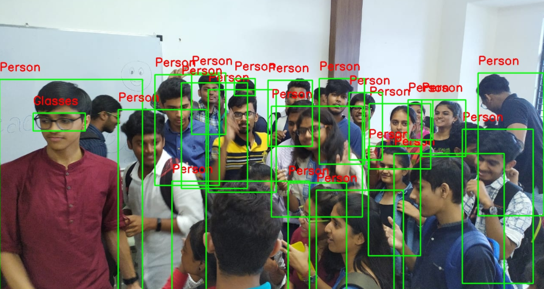
3
IMAGE COMPONENT DETECTOR

Using this extracted information description, interpretation and understanding of the scene can be provided by the machine
Using this extracted information description, interpretation and understanding of the scene can be provided by the machine
Main aim of this project is to extract important data from images.

Slide 9
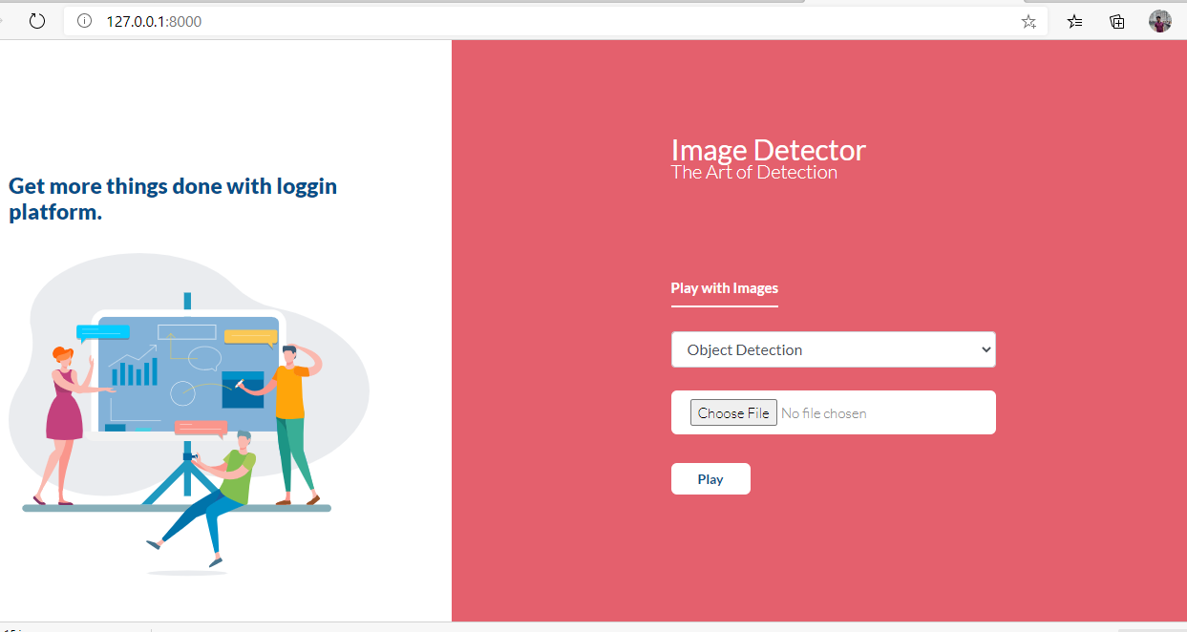
3
CONCLUSION
The goal of this project is to design an all purpose application using various ways of image processing and object detection. Going through different options available, the program will be capable of color recognition, face detection, human counting, and image recognition. For future work, we can conduct a more thorough test of our matching algorithm using larger dataset and more rigorous diagnostics of the algorithm.

Slide 10
User friendly
Easily Available
Available - Multiple Platforms
Free to use
High demand
In our daily life we come across different types of image processing. The best example of image processing in our daily life is our brain sensing a lot of objects/images when we see images with eyes and processing is done in very less time.

Slide 11
2020
Thank you for listening
reporter:-
Gaurav Kumar
Aman Bharti
Aman raj
Chinmay Mandavkar

